Slide 1
MINI PROEJCT PRESENTATION
DROWSINESS DETECTION SYSTEM USING COMPUTER VISION(CV)

Slide 2
INTRODUCTION
Drowsiness affects alertness, concentration, and safety in daily activities.
Manual monitoring of alertness is difficult and time-consuming.
Computer vision can detect facial features like eye movement to identify drowsiness in real time.
The system can trigger alerts to prevent accidents and improve productivity.
Useful in workplaces, classrooms, and vehicles to ensure safety.
Provides a smart, automated, and reliable solution for continuous monitoring.

Slide 3
PROBLEM STATEMENT AND OBJECTIVES
Problem Statement
Drowsiness often goes unnoticed and can lead to accidents, low productivity, or poor performance, so real-time monitoring is essential.
Objectives
Detect drowsiness in real time using facial features.
Trigger alerts when a person is drowsy.
Provide a smart and automated monitoring solution.

Slide 4
ALGORITHMS USED
Media Pipe Face Mesh: Detects facial landmarks (eyes, mouth) from real-time video frames.
Eye Aspect Ratio (EAR): Measures eye openness to detect eye closure and drowsiness.
Mouth Aspect Ratio (MAR): Measures mouth opening to detect yawning.
Threshold & Time-based Logic: Triggers alerts when EAR/MAR cross limits for a fixed duration.

Slide 5
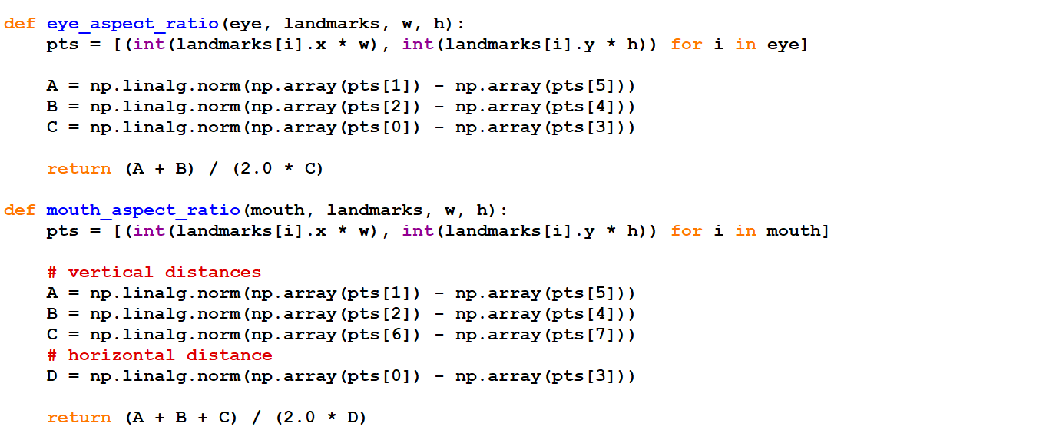
CODE WORKFLOW AND CORE ALGORITHM
Import required libraries
Initialize thresholds & landmarks
Capture webcam frames
Detect facial landmarks (Media Pipe)
Compute EAR & MAR
Apply threshold + time logic
Display alerts
Figure: Implementation of Eye Aspect Ratio (EAR) and Mouth Aspect Ratio (MAR) for drowsiness and yawning detection.

Slide 6
FUTURE ENHANCEMENTS
Use AI to detect drowsiness more accurately.
Give real-time alerts to keep users safe.
CONCLUSION
Enhancing the drowsiness detection system with AI-based detection and real-time alerts will improve its accuracy and responsiveness. This will help keep users alert, prevent accidents, and make the system more reliable and effective overall.

